Slide 1
Native iOS & Android Development with Xamarin
Eng Teong Cheah
@walkercet
Microsoft MVP in Developer Technologies

Slide 2
Tasks
The state of mobile development today
Discuss mobile app trends
Identify approaches to development
Discover the Xamarin Approach

Slide 3

It’s a mobile first, cloud-first world
Our work and personal data is in the cloud

Slide 4

It’s a mobile first, cloud-first world
We have multiple devices and use whichever is best for each task

Slide 5

It’s a mobile first, cloud-first world
We use devices in all aspects of our lives

Slide 6

It’s a mobile first, cloud-first world
We expect our data to be available on every device we use

Slide 7


Mobile app trends
Users prefer apps over browsers on their mobile devices
85% | 90% | 92%
2014 | 2015 | 2016
Mobile Web Browser
Apps

Slide 8
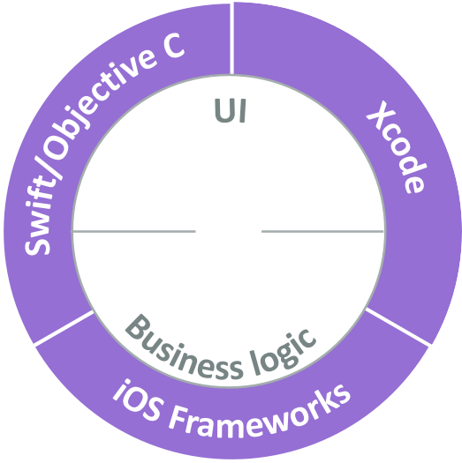
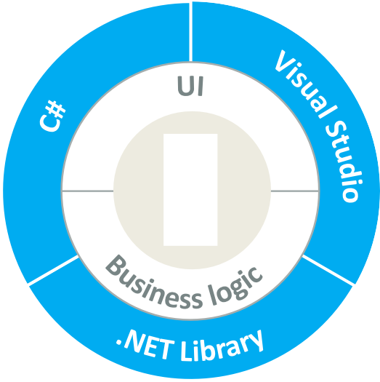
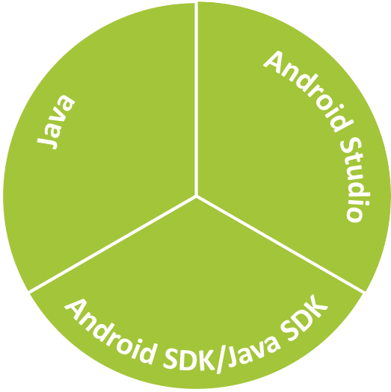






Traditional approach [definition]
Traditionally, apps have separate code bases written in their native language, are built using native tools, and utilize platform-specific features
iOS

Slide 9
Traditional approach [cons]
Traditional app development takes longer, requires multiple teams, multiple IDEs, and cannot share code
double ComputeTax(Item[] items)
{ ...
foreach (var item in items)
...
}
C#
func computeTax(items: [Item]) -> Double
{ ...
for item in items
...
}
double computeTax(Item[] items)
{ ...
for (Item item : items)
...
}
Swift
Java

Slide 10
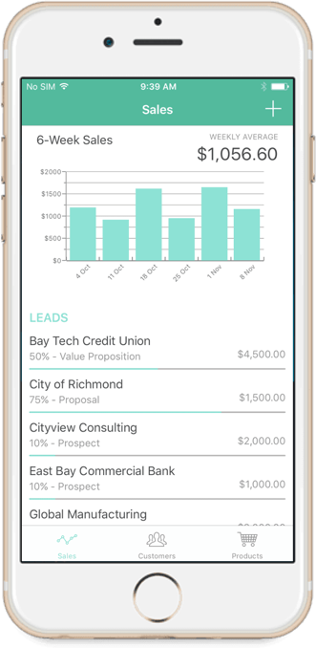
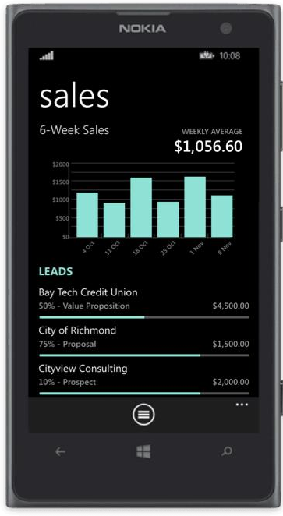
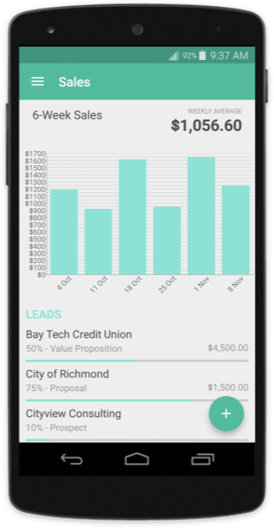
Traditional approach [pros]
Traditional apps typically follow each platform's user-experience guidelines for things like navigation style, page layout, settings, etc.
E.g. implement the navigation style that users of each platform expect

Slide 11
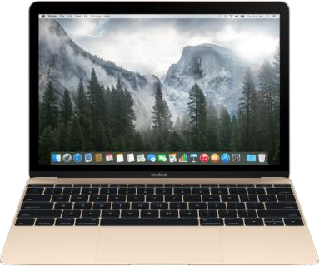
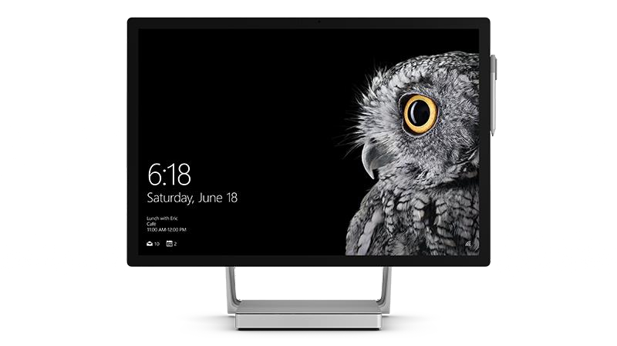
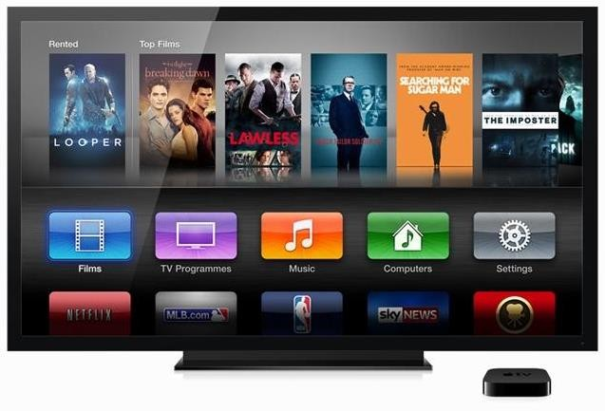
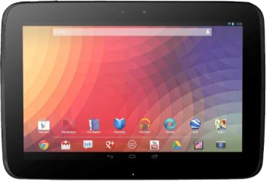
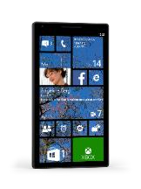


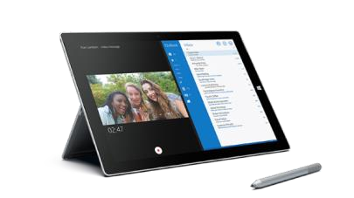



What is Xamarin?
Xamarin is an app-development platform that lets you build apps for many operating systems from a single, shared code base

Slide 12

Xamarin tools
You use Visual Studio, C#, and the .NET Libraries to build Xamarin apps
System.Net | System
System.Data | System.Windows
System.IO | System.Linq
System.Numerics | System.Core
System.Xml | System.ServiceModel
C#
Visual Studio
for Windows or Mac

Slide 13
Xamarin development approaches
Xamarin offers you two strategies: separate UI or shared UI
iOS C# UI | Windows C# UI | Android C# UI
Shared C# business logic
Shared C# UI
Shared C# business logic
Xamarin.iOS and Xamarin.Android
Xamarin.Forms

Slide 14
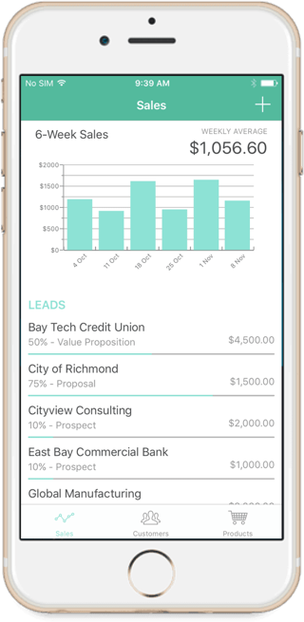
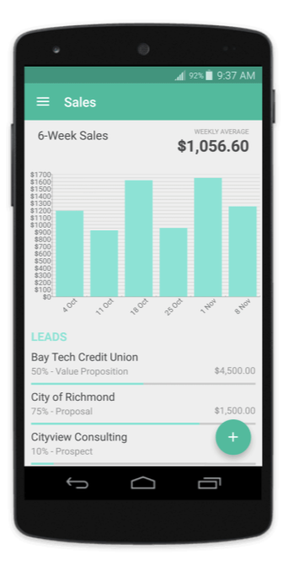
Xamarin.iOS and Xamarin.Android
Create your business logic once and share it across platforms, while leveraging all of the native controls/features your users expect
Shared code base
double ComputeTax(Item[] items)
{ ...
foreach (var item in items)
...
}
Familiar
navigation
Familiar
controls

Slide 15
Xamarin.iOS – 100% API Coverage
Anything you can do in Swift or Objective C for iOS you can do with Xamarin using C#
MapKit
UIKit
iBeacon
CoreGraphics
CoreMotion
System.Net
System
System.IO
System.Linq
System.Xml
System.Data
System.Windows
System.Numerics
System.Core
System.ServiceModel
100% API coverage with the added benefit of the .NET APIs

Slide 16
Xamarin.Android – 100% API Coverage
Anything you can do in Java for Android you can do with Xamarin using C#
Text-to-speech
Toolbar
Printing Framework
Renderscript
NFC
System.Net
System
System.IO
System.Linq
System.Xml
System.Data
System.Windows
System.Numerics
System.Core
System.ServiceModel
100% API coverage with the added benefit of the .NET APIs

Slide 17
Windows
Windows apps are built in C# with all of the Native APIs
Microsoft.Phone
Microsoft.Networking
Windows.Storage
Windows.Foundation
Microsoft.Devices
System.Net
System
System.IO
System.Linq
System.Xml
System.Data
System.Windows
System.Numerics
System.Core
System.ServiceModel
Windows apps support C# natively

Slide 18
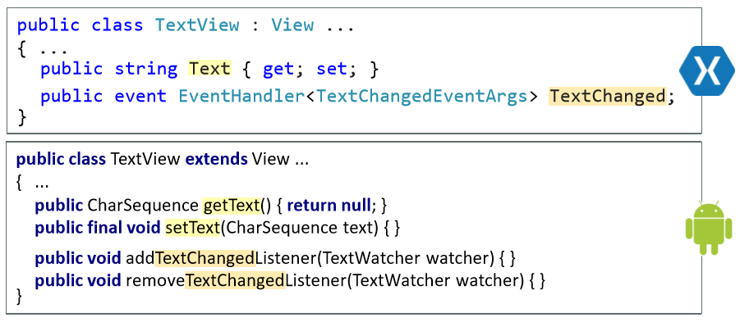
Platform libraries
Xamarin provides a C# version of every native library type

Slide 19
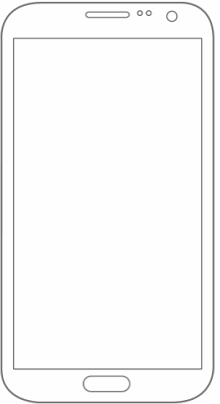
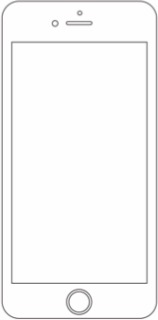


Xamarin performance
Xamarin apps are fully native, you get fully native performance with the benefits of shared code
C# source
Native performance
C# source
Native performance

Slide 20
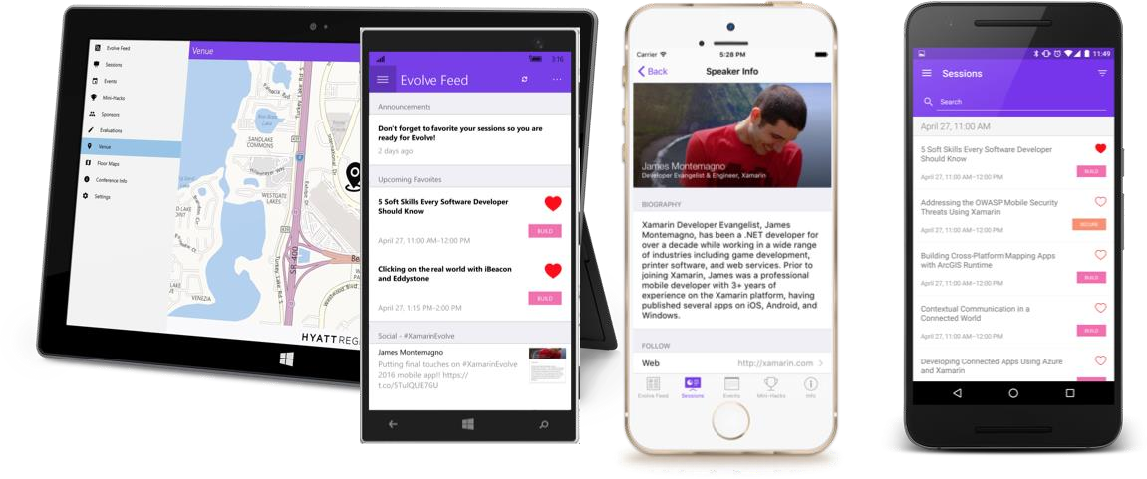
Xamarin.Forms
Xamarin.Forms enables even more code-sharing through a shared UI definition when deep platform integration is unnecessary
Build native UIs for Android, iOS, and Windows from a single, shared C# codebase

Slide 21


Included in Xamarin.Forms
UI building blocks like pages,
layouts, and controls
XAML-defined UI
Data binding
Navigation
Animation API
Dependency Service
Messaging Center
iOS
Shared C# UI
Shared C# business logic

Slide 22
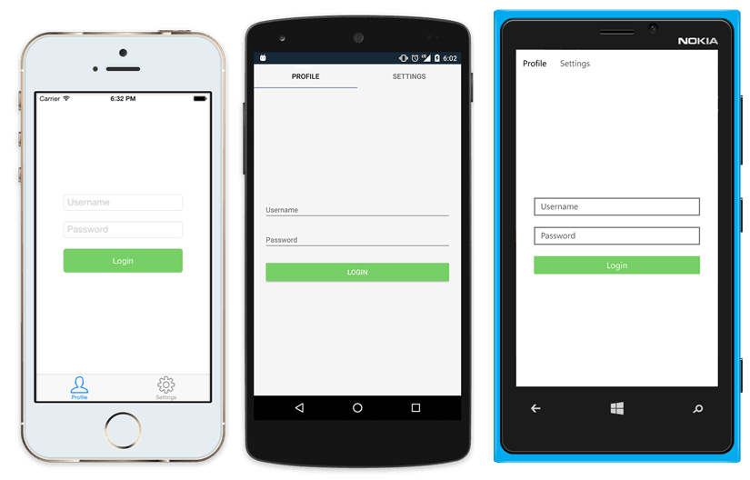
Native controls are used at runtime
<?xml version="1.0" encoding="UTF-8"?>
<TabbedPage xmlns="http://xamarin.com/schemas/2014/forms" xmlns:x="http://schemas.microsoft.com/winfx/2009/xaml" x:Class="MyApp.MainPage">
<ContentPage Title="Profile" Icon="Profile.png">
<StackLayout Spacing="20" Padding="20"
VerticalOptions="Center">
<Entry Placeholder="Username" Text="{Binding Username}"/>
<Entry Placeholder="Password" Text="{Binding Password}" IsPassword="true"/>
<Button Text="Login" TextColor="White" BackgroundColor="#77D065" Command="{Binding LoginCommand}"/>
</StackLayout>
</ContentPage>
<ContentPage Title="Settings" Icon="Settings.png">
</ContentPage>
</TabbedPage>

Slide 23




Xamarin.Forms platform support
Xamarin.Forms supports a broad selection of mobile and desktop platforms and UI frameworks
iOS mac
Shared C# UI
Shared C# logic

Slide 24




Beautiful apps in less time
Create great looking apps that have feature parity with native performance and enjoy the benefit of shared UI and business logic with Xamarin.Forms

Slide 25
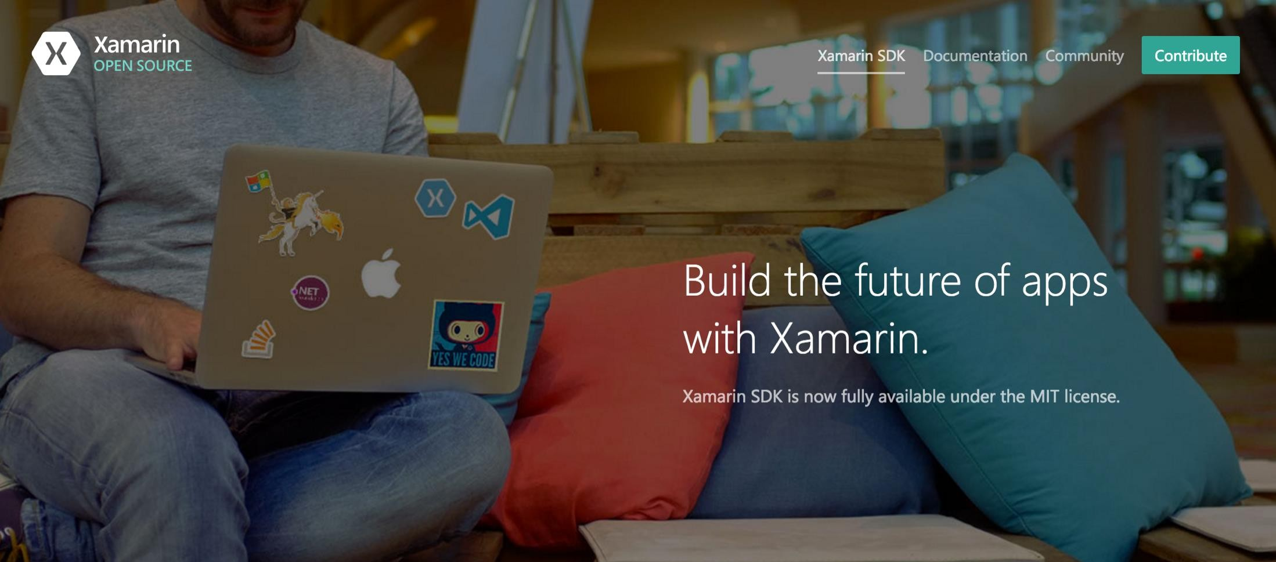
Open Source – open.xamarin.com

Slide 26

One code base, unlimited possibilities
With one code base and native performance you can meet your customers where they need to be

Slide 27
Install Xamarin

Slide 28
Before we start…
Download and launch the Xamarin Installer now on your development machine to begin the automated setup so you are ready when we hit the installation section
Visual Studio Installer https://www.visualstudio.com
Note: for iOS development with Visual Studio on Windows, you also need to set up a Mac with the Xamarin tools.

Slide 29
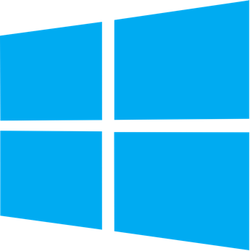

Supported operating systems
Xamarin tools can be installed on macOS and Windows
iOS, Android, and macOS Visual Studio for Mac
iOS, Android, and Windows Visual Studio IDE

Slide 30
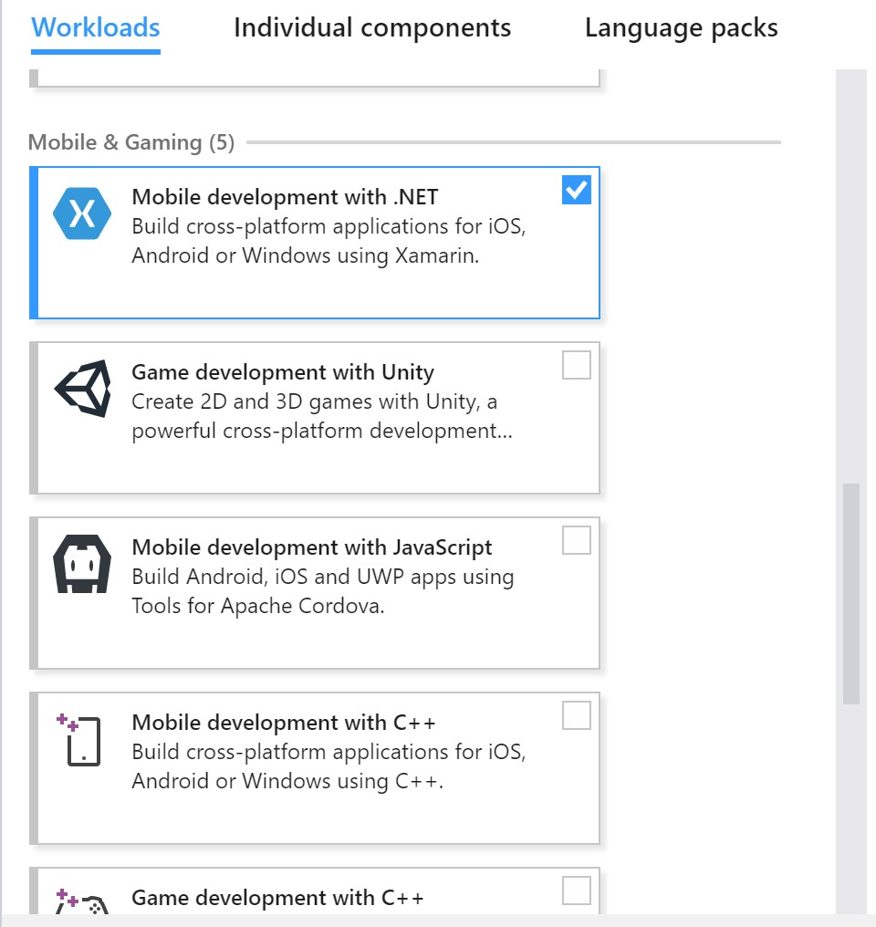
Install on Windows
On Windows, Xamarin installs directly from the Visual Studio Installer
Make sure the Mobile development
with .NET Workload is
selected

Slide 31
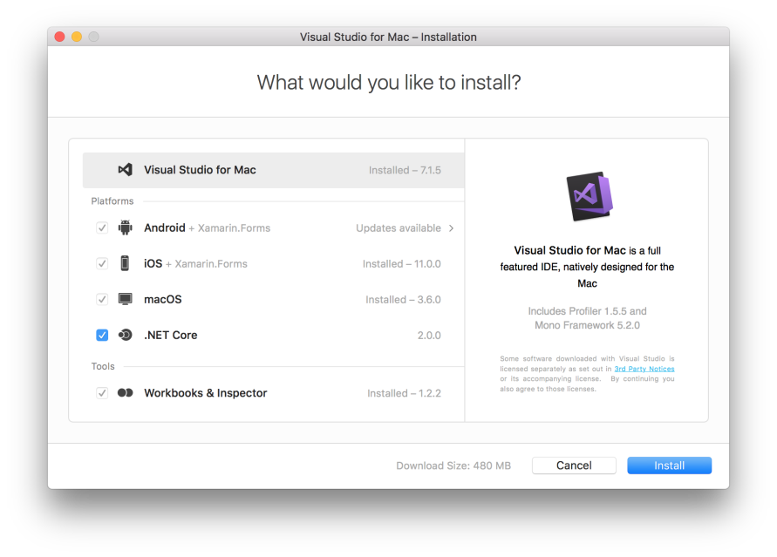
Install on a Mac
When developing on a Mac, the first thing you should do is install Xcode and use the Xamarin Unified Installer to download and install required components

Slide 32

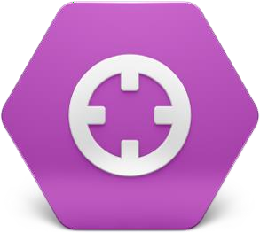



Visual Studio Enterprise benefits
There are additional benefits included with a Visual Studio Enterprise license
Bytecode hiding
for Android APKs
Live app inspector
Profiler
Test Recorder
Important: Make sure to use the Enterprise installer from the Visual Studio download page to ensure you get the correct edition of the development environment installed!

Slide 33
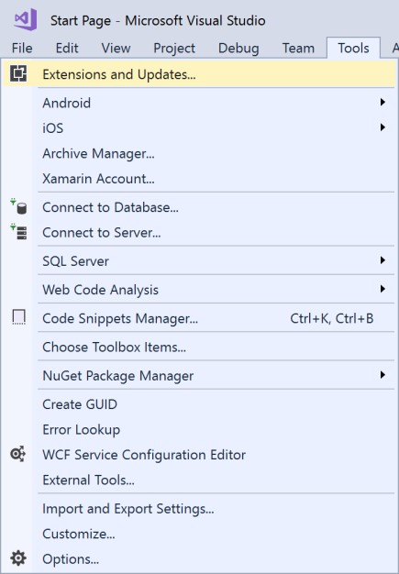
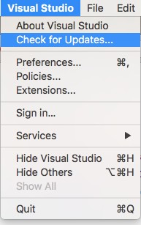
Keep Xamarin up to date
Xamarin releases updates to add new APIs, match vendor releases, and fix issues
Visual Studio on Windows
Visual Studio for Mac

Slide 34
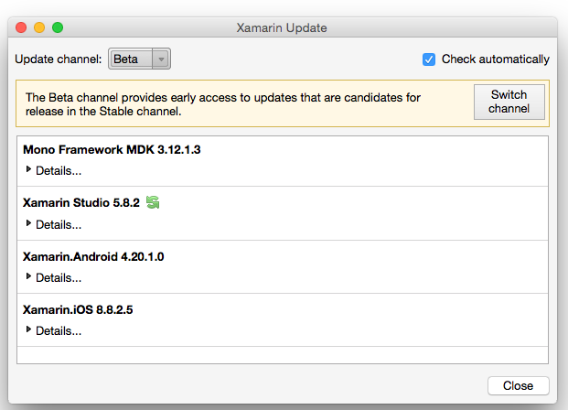
Xamarin macOS release channels
Xamarin updates are deployed in stages for macOS, and exposed through release channels (Alpha > Beta > Stable)
Alpha: most current, least tested
Beta: what's next
Stable: released code, most tested
Important: We recommend the stable channel for most classes

Slide 35
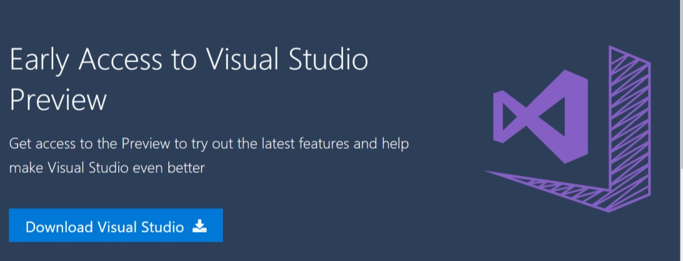
Xamarin pre-release on Windows
Xamarin early access releases are deployed with Visual Studio Preview, available for download
Important: We recommend the standard Visual Studio release for most classes

Slide 36

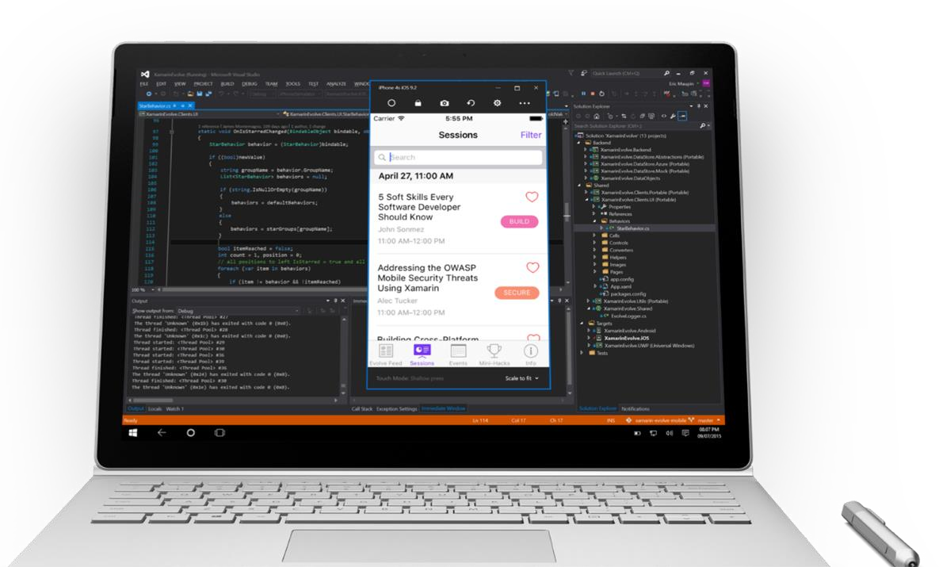



iOS Development Requires a Mac
Delegates parts of the build to a Mac using a server process called the Xamarin Mac Agent

Slide 37
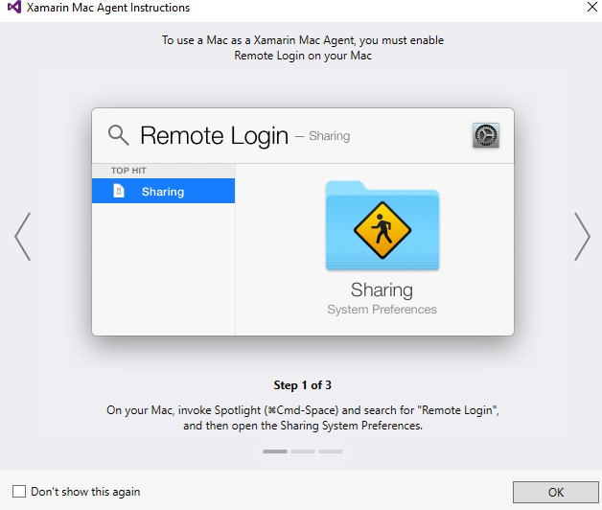
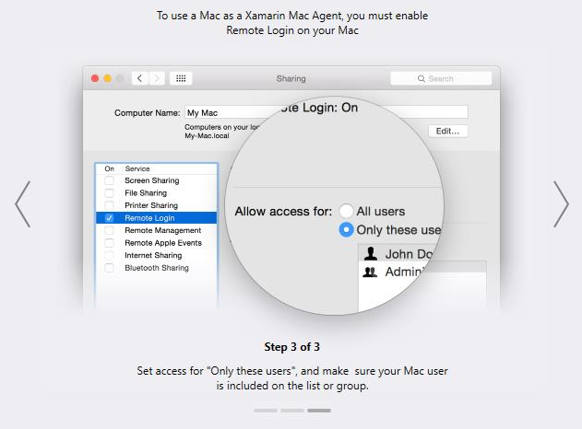
Connecting to Mac Agent
Creating or opening an iOS project in VS will login to the associated Mac host, if no host is available, it will launch the connection wizard
You can also use Tools > iOS > Xamarin Mac Agent to launch connection wizard
manually to connect to a different host

Slide 38



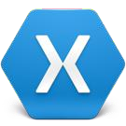


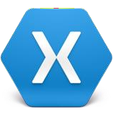
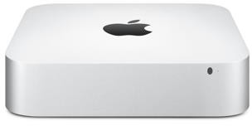
Connecting to the Mac
Building an iOS application will automatically connect to the build agent
Visual Studio with Xamarin Tools
Mac Host with Xamarin Tools and Xcode
SSH Session
Starting connection to Mac 192.168.0.193... Starting Broker in port 54837...
Connection successfully established with the Mac 192.168.0.193:54837 Starting agents on Mac 192.168.0.193 (192.168.0.193)
Starting Agent IDB... Starting Agent Build... Starting Agent Designer... Agent Build is running Agent IDB is running Agent Designer is running
Connected to the Mac 192.168.0.193 (192.168.0.193) with Full support.

Slide 39
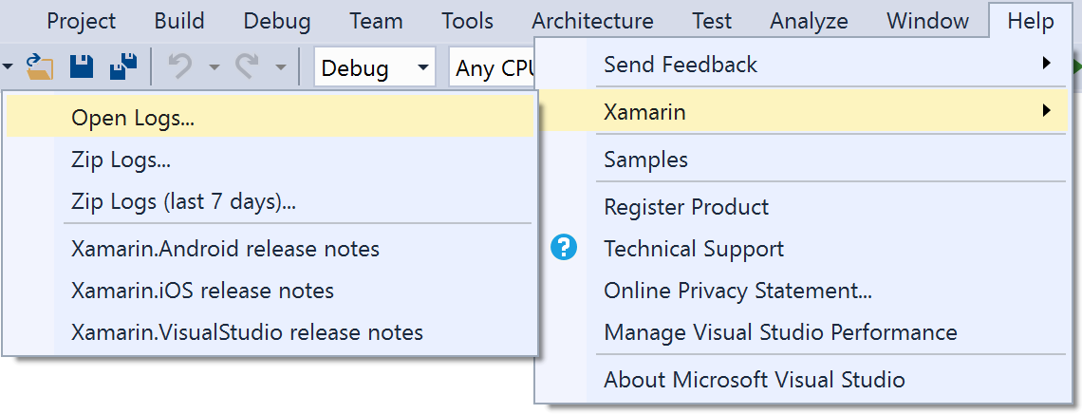
Troubleshooting Xamarin Mac Agent
The Xamarin Mac Agent will generally diagnose and help correct connection issues; use Help > Xamarin for more detailed log information if necessary

Slide 40










Running your applications
You need to run applications to test them – can run on devices, or use emulators and simulators which simulate a real device in software
iOS, Android, and Windows all have emulators or simulators

Slide 41
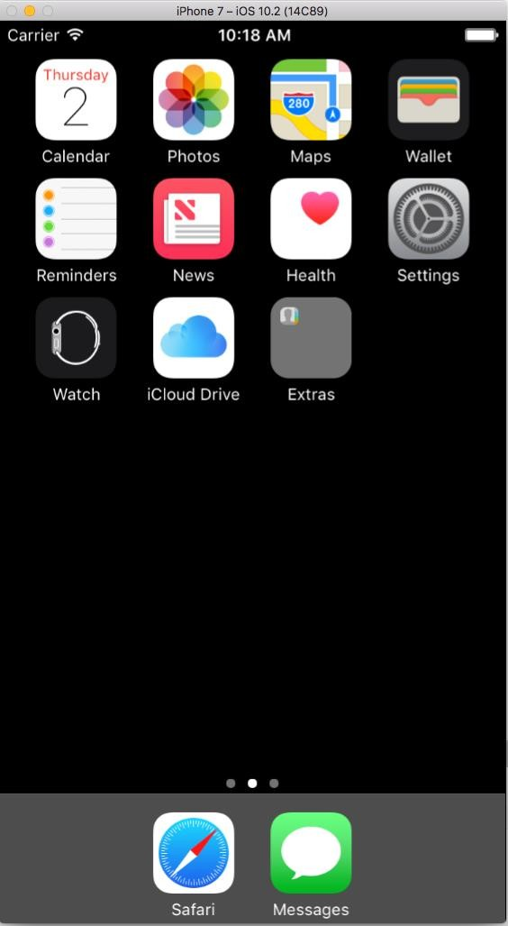
Running iOS apps
Apple supplies an iOS simulator with Xcode which can be launched on the Mac host
The simulator supports different devices, resolutions
Only the latest iOS release is installed by default, but you can use Xcode to install older
iOS versions

Slide 42
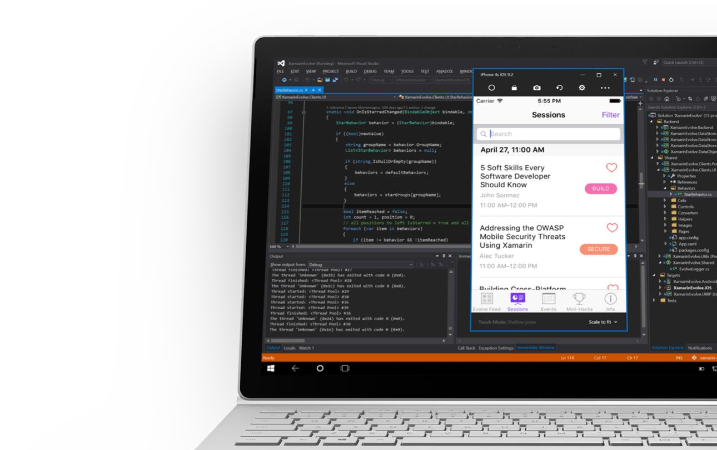
Remoted iOS Simulator (for Windows)
The Remoted iOS Simulator for Windows makes testing and debugging iOS apps is entirely possible within Visual Studio Enterprise on Windows
Supports rotation, screenshots, and
location changes
Multi-touch and pressure-sensitive interaction
Performant

Slide 43
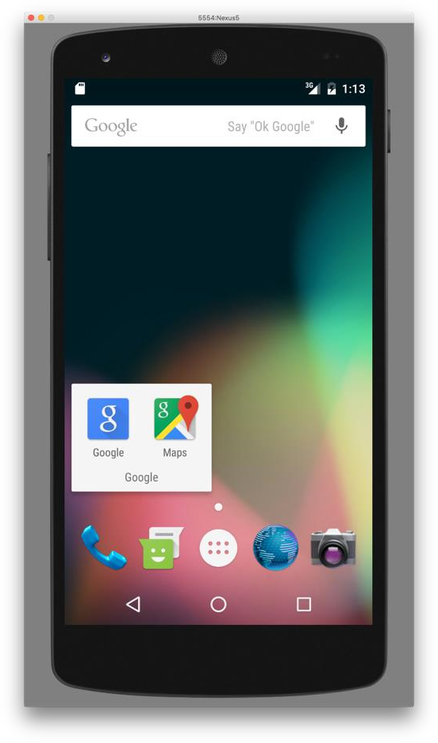
Running Android apps
Google provides the standard Android emulator and includes it with the Android SDK and often include Google apps support automatically
Improved emulator engine and configuration support is available if you install the
Android Studio IDE from Google

Slide 44
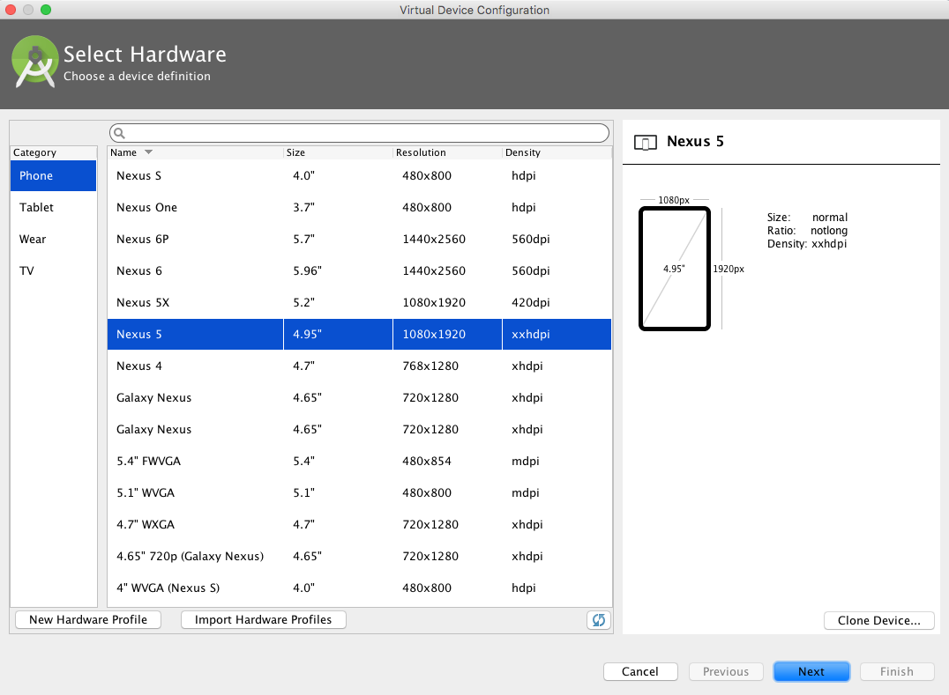
Installing the Google emulators
Google supports the widest variety of Android devices and versions
Includes TV and wearable definitions

Slide 45
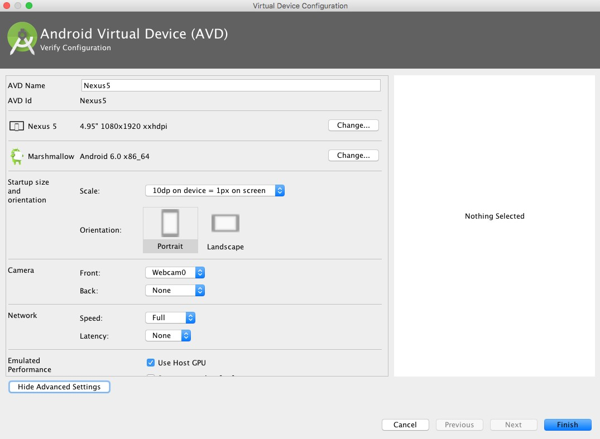
Creating a new Google emulator
Android Studio provides access to a much nicer configuration dialog

Slide 46
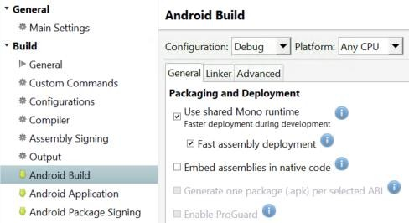
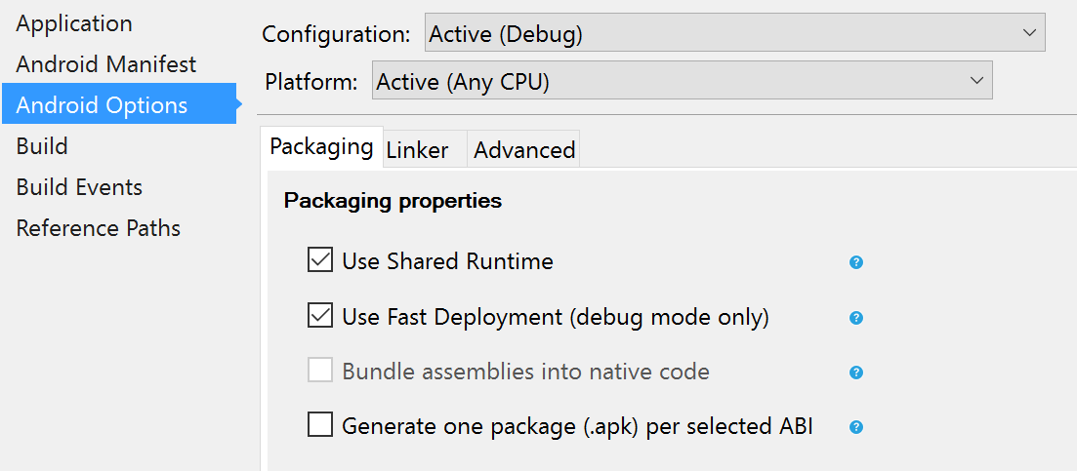
Running apps on Android emulators
Some Android emulators do not support the "Fast Deployment" optimization which updates the app in-place on the device, if your application will not install, try turning this feature off in the project settings

Slide 47
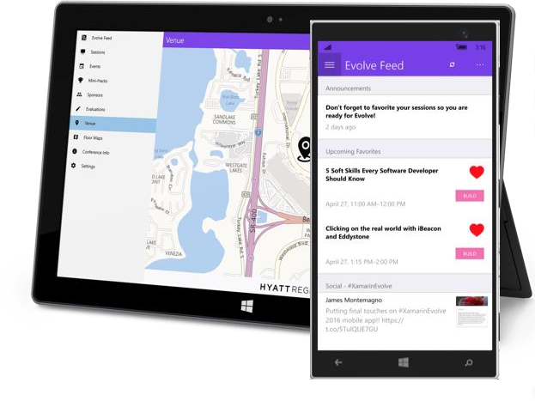
Running UWP apps (Windows)
Visual Studio can deploy to local or remote Windows 10 devices as well as a optional Windows simulators
Be aware that simulators require Hyper-V and can interfere with virtualization software like VMware and Virtual Box

Slide 48
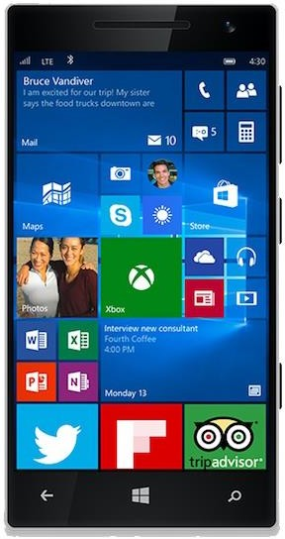
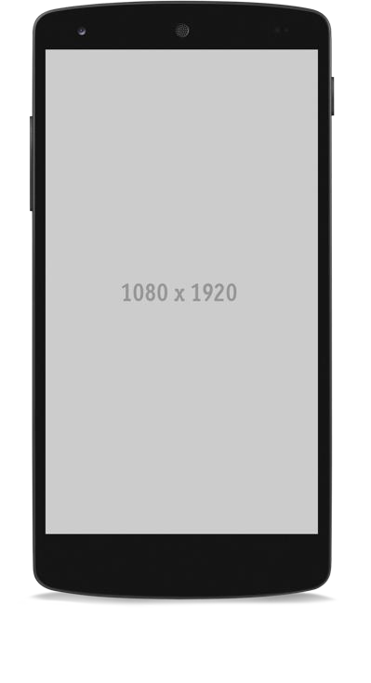
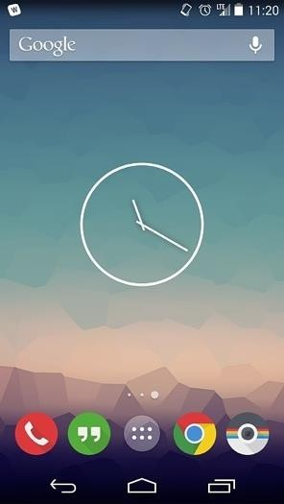
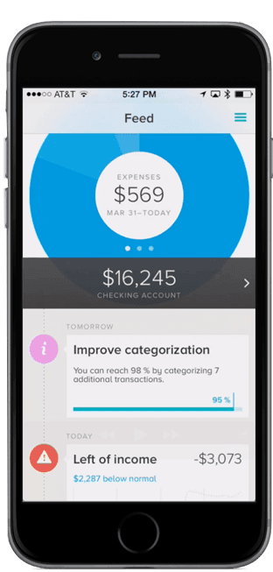
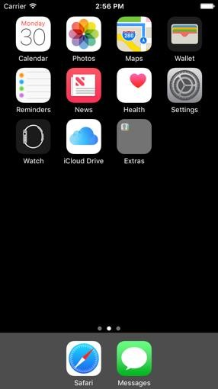
Using a real device
Can use a physical device to run and debug your applications – requires some one-time platform-specific setup
iOS: http://bit.ly/1R7YmH8
Android: http://bit.ly/1PjDlFz
Windows: http://bit.ly/2nsGf7i

Slide 49
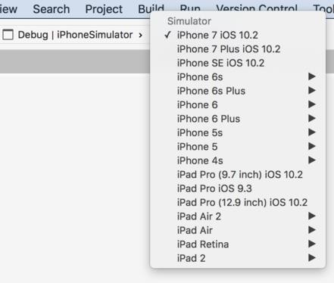
Selecting a device or emulator
Select the device (or emulator) to run your project using the drop-down on the Standard Toolbar

Slide 50
Thank You
Eng Teong
Cheah
Microsoft MVP in Developer Technologies
@walkercet

